Slide 1
National income and its concepts

Slide 2

Measuring the Value of Economic Activity
1. Gross Domestic Product (GDP) : Money value of all final goods and services produced within the domestic territory of a country during in an accounting year.

Slide 3
GDP= (Price of mobiles × Quantity of mobiles) + (Price of laptops × Quantity of laptops).
 | Price (M) In ‘000’ | # Mobiles | Price (L) In ‘000’ | # Laptops | GDP in lakhs
2019 | Rs. 20 | 20 | Rs. 50 | 10 | (20x20 + 50x10)=9
2020 | Rs. 25 | 20 | Rs. 60 | 10 | (25X20 + 60x10)=11

Slide 4
2. Gross National Product (GNP) : Money value of final goods and services produced by domestically owned factors of production with in a given period.
GNP= GDP+ factor payment from abroad- factor payment to abroad
the difference is net income earned by foreigners

Slide 5
3. Net domestic product (NDP) : GDP- depreciation
4. Net National Product (NNP) : NNP-depreciation
5. National Income
NNP approximately equal to National Income ( NI) , with statistical discrepancy

Slide 6
6.Personal income : National income – Indirect taxes
-- Corporate profits
-- Social insurance contribution
-- Net interest
+ Dividends
+ Government transfers to individuals
Personal Disposable Income (PDI) = PI – [ Personal tax & non-tax payments]

Slide 7
Real versus Nominal GDP
Real GDP: Not influenced by changes in prices
Nominal GDP: measured at current prices
Real GDP: Measured at constant prices
GDP deflator: = (NGDP/RDGP)x100
GDP PCI
Are GDP a good measure of economic well being?

Slide 8

Physical Quality of Life Index (LR, IMR,LEB,
Human Development Index (LEB, Education Index, standard of living)
Gross National Happiness Index ( Governance, socio-economic development, cultural preservation, environmental conservation)

Slide 9

Measurement of National Income
Can be measured by three alternative methods:
(i) Product Method
Money value of all final goods and services

Slide 10
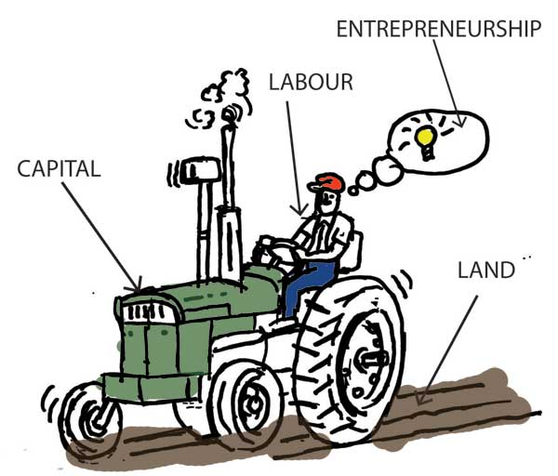
Rent : Land Wage: Labour Interest : Capital Profit : Entrepeneurship
(ii) Income Method

Slide 11
(iii) Expenditure Method
■ Consumption (C ) : Non durable, durable and services
■ Investment (I ) : Fixed capital: Goods bought for future use ■ Government purchases (G) Federal, state and local Govt.’s purchases ■ Net exports (NX ). Net trade with other countries
Y= C+ I+ G+ NX ( National Income Identity)

Slide 12
Calculate GDP (income method and expenditure method
Sno | items | Rs in crores
1 | Interest | 150
2 | Rent | 250
3 | Govt final consumption expenditure | 600
4 | Private final consumption expenditure | 1200
5 | Profits | 640
6 | Compensation to employees | 1000
7 | Net factor income from abroad | 30
8 | Net indirect taxes | 60
9 | Net exports | -40
10 | Consumption of fixed capital | 50
11 | Net domestic capital formation | 340

Slide 13
National Income
Income method= 150+ 250+640+1000=2040 cr
Expenditure method= 600+1200+(-40)+ 340+ (-50)= 2050 cr

Slide 14
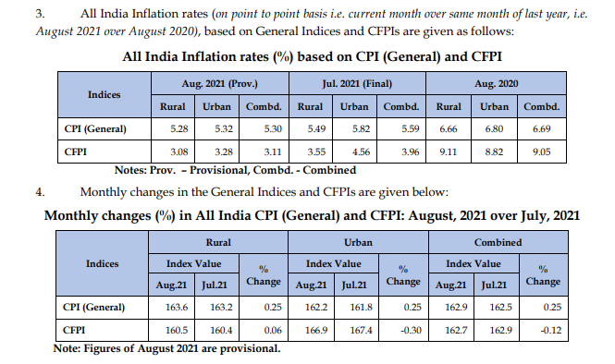

Slide 15
Measuring the cost of living
Consumer Price index:
Measure the changes in price paid by consumer for goods and services
The market value of a typical basket of goods
1. Select item for the basket
2. Find prices
3. Total cost
4. Pick base year and compute index
5. Compute inflation rate

Slide 16
CPI Basket
Food & Beverages
Cereals and Product
Meat and Fish
Egg
Milk and products
Oils and Fats …..

Slide 17
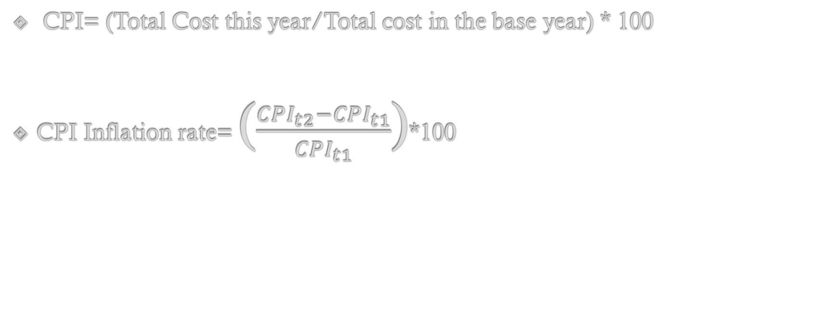
CPI= (Total Cost this year/Total cost in the base year) * 100
CPI Inflation rate= ($\frac{{CPI}_{t2}−{CPI}_{t1}}{{CPI}_{t1}}$)*100

Slide 18
Year | Total | CPI | Inflation
2010 | 522 | 100.00 | ---
2011 | 544 | 104.2 | 4.2%
2012 | 532
2013 | 560
2014 | 577
2015 | 600

Slide 19
How does CPI Help?
The RBI and other statistical agencies study CPI to understand the price changes of various commodities and a tab on inflation
Also helpful in understanding the real value of wages and salaries

Slide 20
CPI in India
Labour Bureau
CPI for Industrial Workers (IW)-----2016
CPI for Agricultural Labourers (AL)
CPI for Rural Labourers (RL) and
CPI for Urban Labourers
MoSPI
CPI for Urban Non-Manual Employees (UNME).

Slide 21
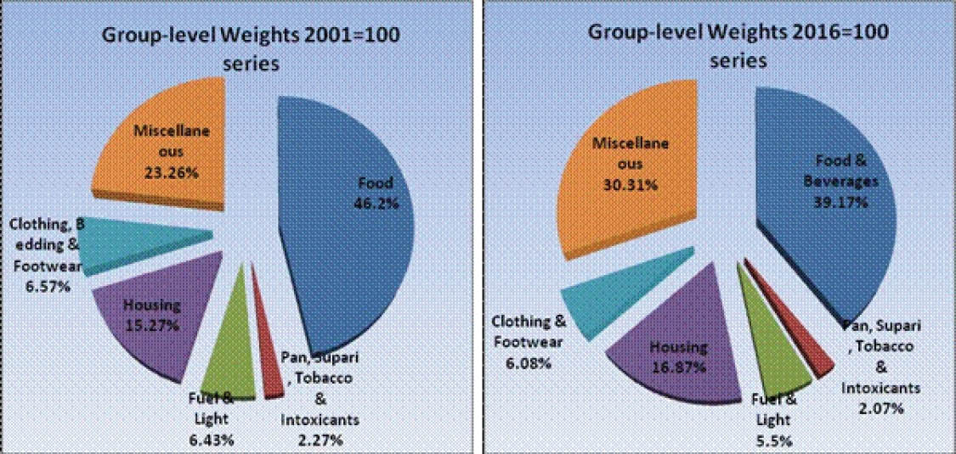
How it weights?

Slide 22
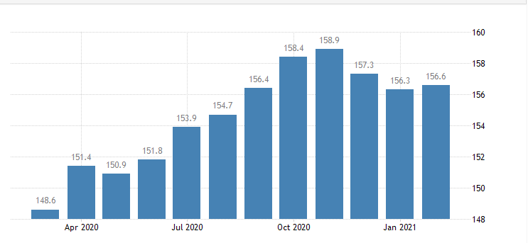

Slide 23
Problems with CPI
1. Substitution
2. New Goods
3. Quality
4. may not be applicable to all population group
5. social and environmental factors are beyond the scope
6. Two areas can’t be compared

